Slide 1

Kicad 6
Gert Lauritsen

Slide 2



Dagsorden
Gennemgang / demoproject
Komponent søgning
BOM
PCB Panelization

Slide 3
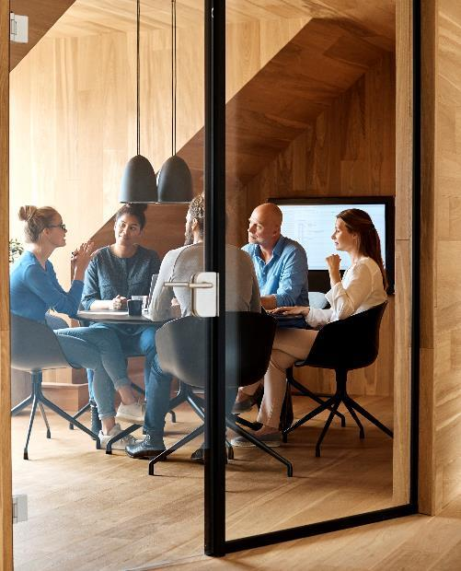



Introduktion
.

Slide 4

Kicad
The road that we take is lost in the flood

Slide 5
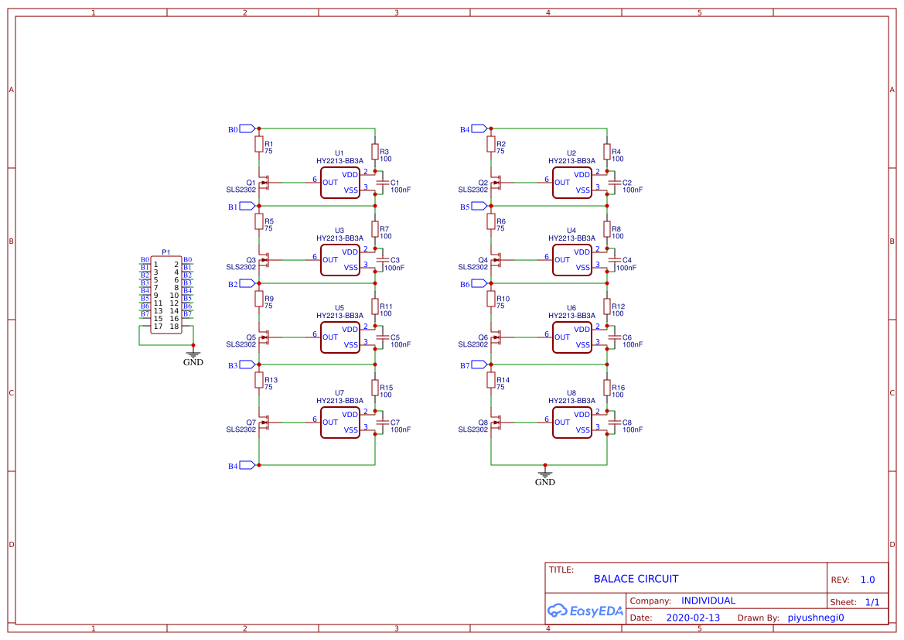
Opgave 1

Slide 6
SnapEda
The road that we take is lost in the flood

Slide 7
Library Loader
https://ms.componentsearchengine.com/pcb-libraries.php

Slide 8
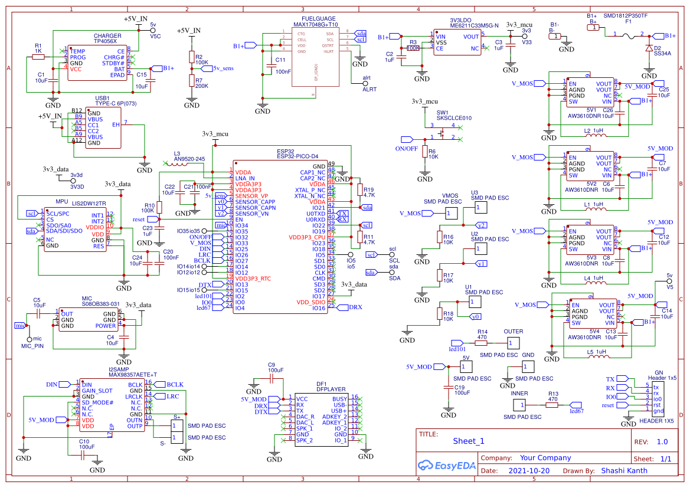
Opgave2

Slide 9
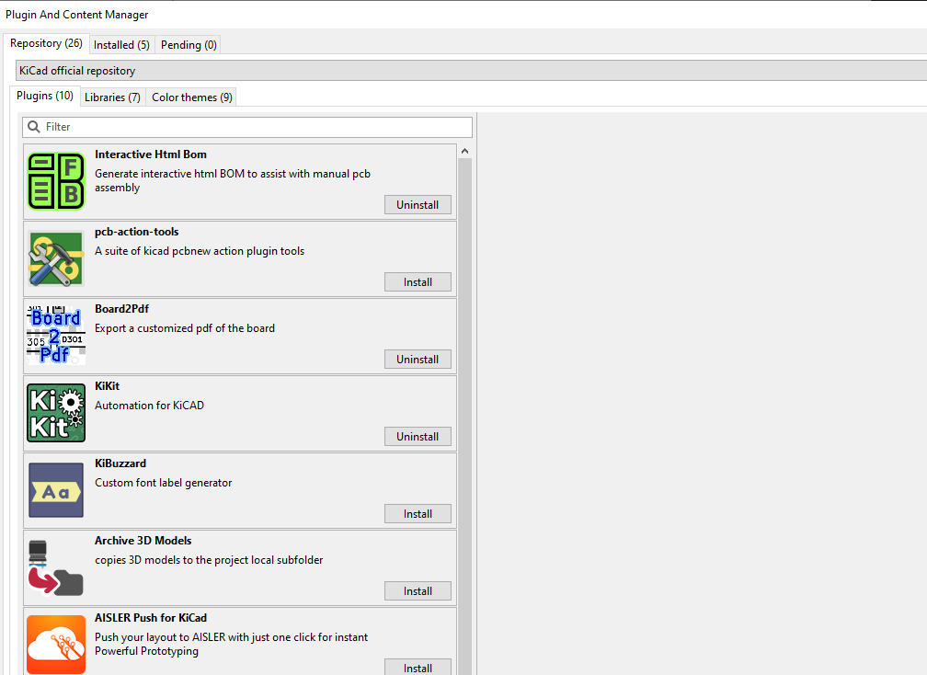
BOM
https://github.com/openscopeproject/InteractiveHtmlBom

Slide 10
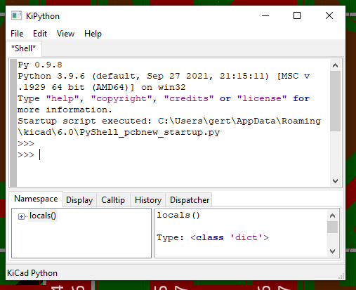
Panel
{
"layout": {
"hspace": "2mm",
"vspace": "2mm",
"rotation": "90deg",
"rows": "3",
"cols": "10"
},
"tabs": {
"type": "fixed"
},
"cuts": {
"type": "mousebites",
"spacing": "1mm",
"offset": "0.2mm"
},
"framing": {
"type": "railstb",
"width": "5mm"
},
"fiducials": {
"type": "3fid",
"hoffset": "2mm",
"voffset": "2mm"
},
"text": {
"type": "simple"
},
"post": {
"millradius": "1mm"
}
}
https://github.com/yaqwsx/KiKit

Slide 11


Tak
Gert Lauritsen
Gert@askob.dk

